Slide 1
Teaching Disciples: Part 2
Real Commitment
2024 Quarter 3 Lesson 08
Mark 10

Slide 2
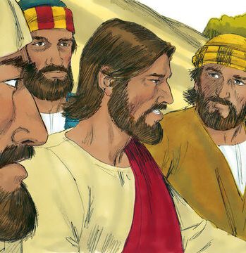
The Marriage Commitment
Mark 10:1-12
And he arose from thence, and cometh into the coasts of Judaea by the farther side of Jordan: and the people resort unto him again; and, as he was wont, he taught them again.

Slide 3
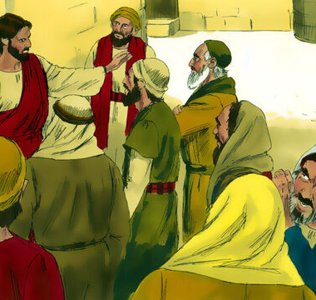
The Marriage Commitment
Mark 10:2-12
2 And the Pharisees came to him, and asked him, Is it lawful for a man to put away his wife? tempting him.

Slide 4
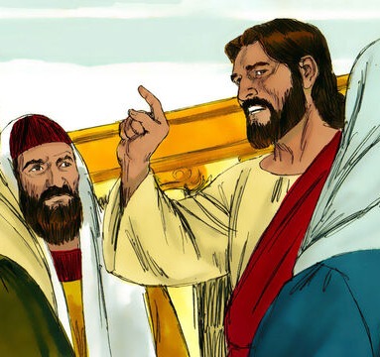
The Marriage Commitment
Mark 10:3-12
3 And he answered and said unto them, What did Moses command you?

Slide 5
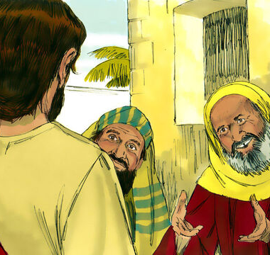
The Marriage Commitment
Mark 10:4-12
4 And they said, Moses suffered to write a bill of divorcement, and to put her away.

Slide 6
What did Moses Command?
Leviticus 20:10
“And the man that committeth adultery with another man's wife, even he that committeth adultery with his neighbour's wife, the adulterer and the adulteress shall surely be put to death.”

Slide 7
What did Moses Command?
Under the Mosaic law the penalty for marital unfaithfulness was death, not divorce. Furthermore, under Moses’ law the death penalty was mandatory… at least at first.

Slide 8
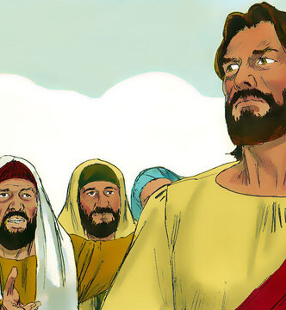
The Marriage Commitment
Mark 10:5-12
5 And Jesus answered and said unto them, For the hardness of your heart he wrote you this precept.

Slide 9
What did Moses Command?
Deuteronomy 24:1-4
“When a man hath taken a wife, and married her, and it come to pass that she find no favour in his eyes, because he hath found some uncleanness in her: then let him write her a bill of divorcement, and give it in her hand, and send her out of his house.
2 And when she is departed out of his house, she may go and be another man's wife.”

Slide 10
What did Moses Command?
Deuteronomy 24:1-4
“3 And if the latter husband hate her, and write her a bill of divorcement, and giveth it in her hand, and sendeth her out of his house; or if the latter husband die, which took her to be his wife;
4 Her former husband, which sent her away, may not take her again to be his wife, after that she is defiled; for that is abomination before the Lord: and thou shalt not cause the land to sin, which the Lord thy God giveth thee for an inheritance.”

Slide 11
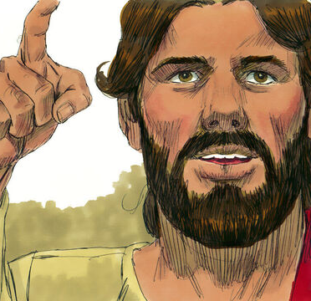
The Marriage Commitment
Mark 10:5-12
6 But from the beginning of the creation God made them male and female.

Slide 12
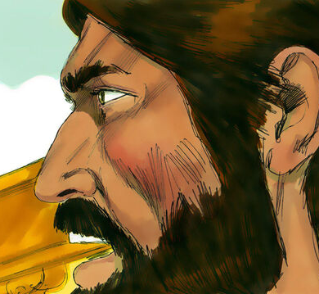
The Marriage Commitment
Mark 10:7-12
7 For this cause shall a man leave his father and mother, and cleave to his wife;
8 And they twain shall be one flesh: so then they are no more twain, but one flesh.

Slide 13
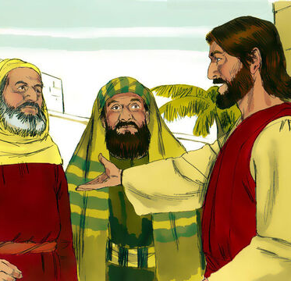
The Marriage Commitment
Mark 10:9-12
9 What therefore God hath joined together, let not man put asunder.

Slide 14
What did GOD Command?
The law of Genesis 1 and 2 preceded the law of Deut. 24:1-4 and is superior to it, for in the Eden period of Genesis, God’s ideal for His human children is set forth. God has never repealed the law of marriage He enunciated in the beginning. It was not God’s plan that divorce should ever be necessary.

Slide 15
What did GOD Command?
The only change made to accommodate the original marriage law to a fallen world is that violation of the marriage contract by unchastity may constitute a lawful basis for dissolving the union. Otherwise, the union may not lawfully be broken.

Slide 16
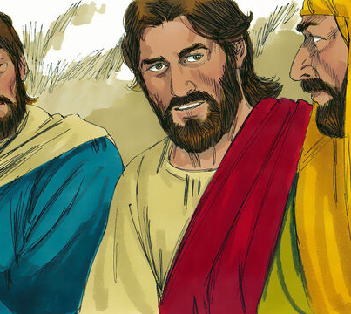
The Marriage Commitment
Mark 10:9-12
10 And in the house his disciples asked him again of the same matter.

Slide 17
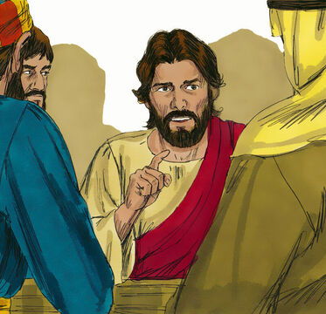
The Marriage Commitment
Mark 10:11-12
11 And he saith unto them, Whosoever shall put away his wife, and marry another, committeth adultery against her.

Slide 18
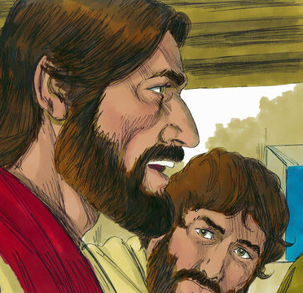
The Marriage Commitment
Mark 10:12
12 And if a woman shall put away her husband, and be married to another, she committeth adultery.

Slide 19
SDABC on Matthew 19:10
“
“It would seem that the disciples had not clearly understood Jesus’ earlier statements with respect to marriage, and that hence they were deeply perplexed by the interpretation Jesus had just given.”
”

Slide 20
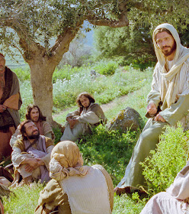
A Sincere Commitment
Mark 10:13-16
13 And they brought young children to him, that he should touch them: and his disciples rebuked those that brought them.

Slide 21
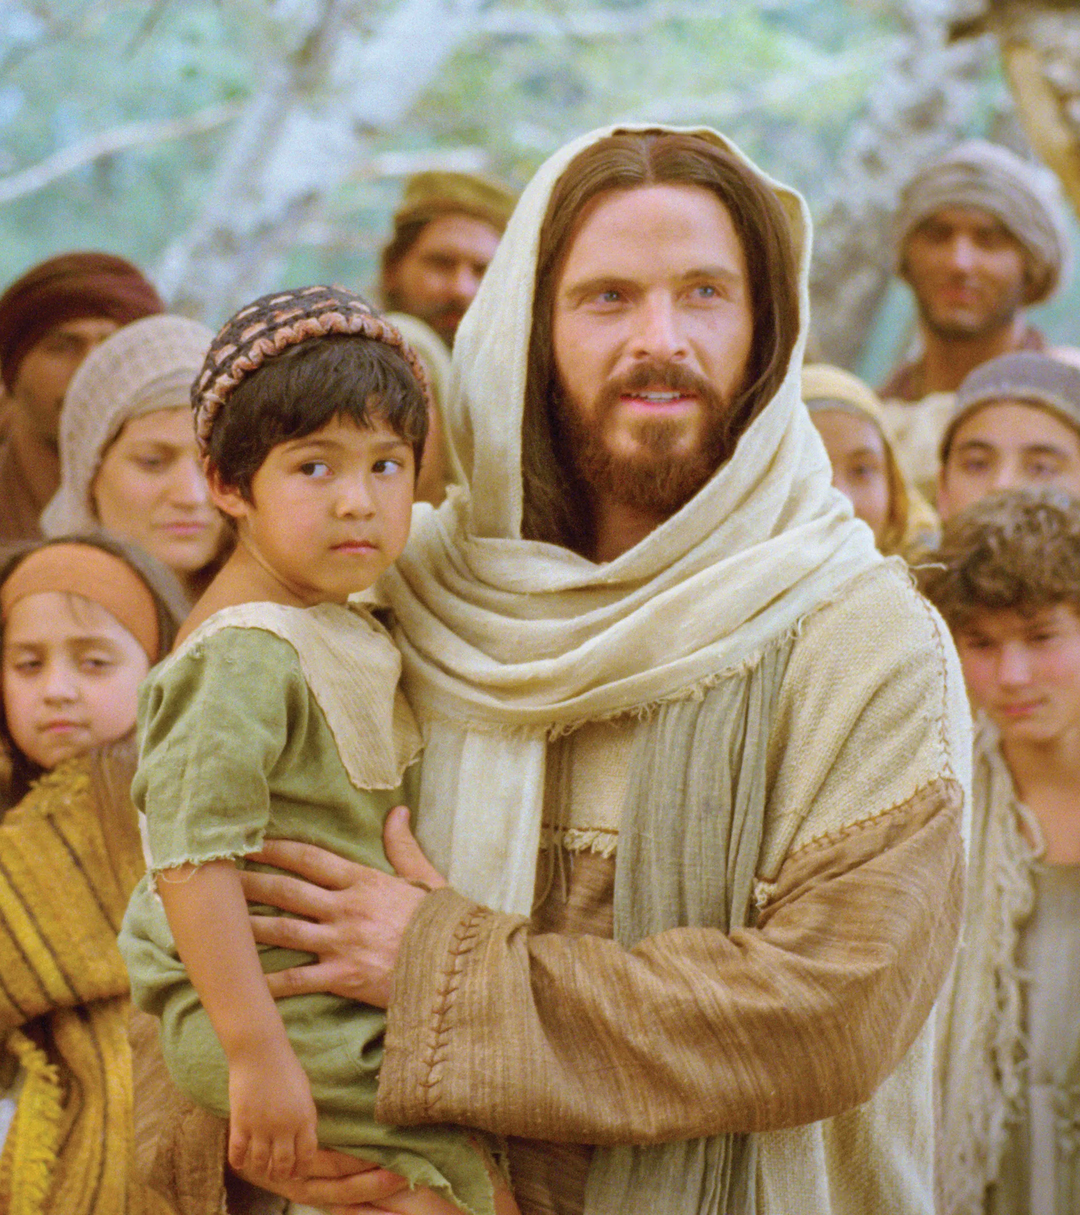
A Sincere Commitment
Mark 10:14-16
14 But when Jesus saw it, he was much displeased, and said unto them, Suffer the little children to come unto me, and forbid them not: for of such is the kingdom of God.

Slide 22
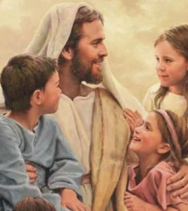
A Sincere Commitment
Mark 10:15-16
15 Verily I say unto you, Whosoever shall not receive the kingdom of God as a little child, he shall not enter therein.

Slide 23
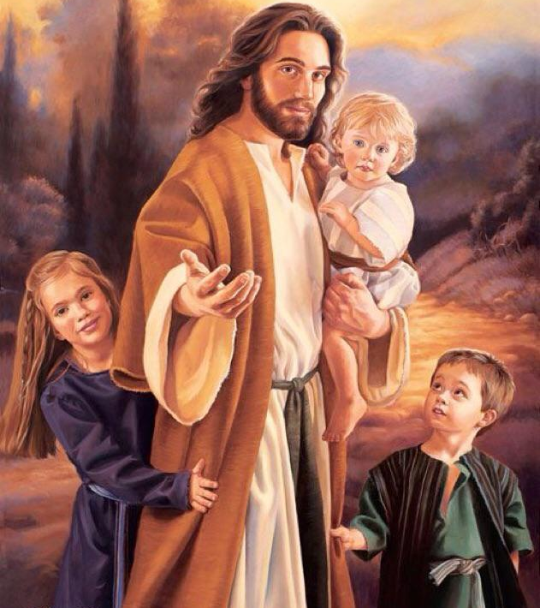
A Sincere Commitment
Mark 10:16
16 And he took them up in his arms, put his hands upon them, and blessed them.

Slide 24
“Before honor is humility. To fill a high place before men, Heaven chooses the worker who, like John the Baptist, takes a lowly place before God. The most childlike disciple is the most efficient in labor for God. The heavenly intelligences can co-operate with him who is seeking, not to exalt self, but to save souls.”
The Desire of Ages p.436

Slide 25
“He who feels most deeply his need of divine aid will plead for it; and the Holy Spirit will give unto him glimpses of Jesus that will strengthen and uplift the soul. From communion with Christ he will go forth to work for those who are perishing in their sins. He is anointed for his mission; and he succeeds where many of the learned and intellectually wise would fail.”
The Desire of Ages p.436

Slide 26
“But when men exalt themselves, feeling that they are a necessity for the success of God's great plan, the Lord causes them to be set aside. It is made evident that the Lord is not dependent upon them. The work does not stop because of their removal from it, but goes forward with greater power.”
The Desire of Ages p.436

Slide 27
“It was not enough for the disciples of Jesus to be instructed as to the nature of His kingdom. What they needed was a change of heart that would bring them into harmony with its principles. Calling a little child to Him, Jesus set him in the midst of them; then tenderly folding the little one in His arms He said,”
The Desire of Ages p.437

Slide 28
“Except ye be converted, and become as little children, ye shall not enter into the kingdom of heaven.” The simplicity, the self-forgetfulness, and the confiding love of a little child are the attributes that Heaven values. These are the characteristics of real greatness.”
The Desire of Ages p.437

Slide 29
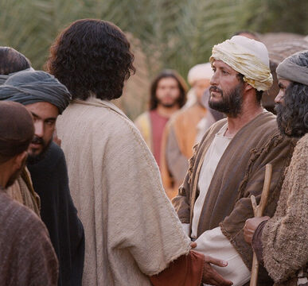
A Priority Commitment
Mark 10:17-27
17 And when he was gone forth into the way, there came one running, and kneeled to him, and asked him, Good Master, what shall I do that I may inherit eternal life?

Slide 30
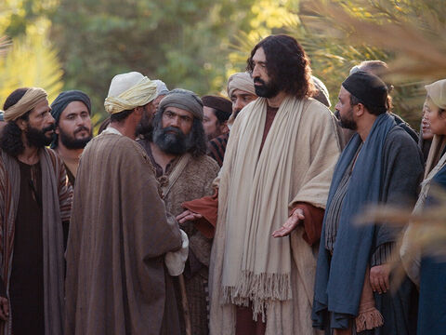
A Priority Commitment
Mark 10:18-27
18 And Jesus said unto him, Why callest thou me good? there is none good but one, that is, God.

Slide 31
SDABC on Matthew 19:17
“
Evidently the manner in which the young man addressed Jesus was quite unusual. There seems to be no record in rabbinical literature that rabbis were ever addressed as “good.” On the contrary, in the Mishnah, God Himself is spoken of as “He that is good and bestows good” ( Berakoth 9.2, Soncino ed. of the Talmud, p. 327).
”

Slide 32
SDABC on Matthew 19:17
“
The young man’s station in life and his office of public trust indicate that he did not call Jesus “good Master” out of ignorance or carelessness. It was obvious that he had a reason for doing so, and Jesus sought to draw out of him a public statement of that reason.
”

Slide 33
SDABC on Matthew 19:17
“
Jesus’ explanation, “there is none good but one” was to help the young man to realize clearly the import of his salutation. Jesus recognized the sincerity and discernment of the young man, and thought to strengthen his faith by drawing out of him an even clearer statement of it.
”

Slide 34
SDABC on Matthew 19:17
“
Supreme goodness is a characteristic of God alone. Jesus does not disavow His deity, as might at first appear, but rather clarifies and emphasizes the full significance of the young man’s statement.
”

Slide 35
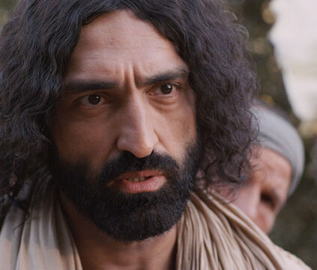
A Priority Commitment
Mark 10:19-27
19 Thou knowest the commandments, Do not commit adultery, Do not kill, Do not steal, Do not bear false witness, Defraud not, Honour thy father and mother.

Slide 36
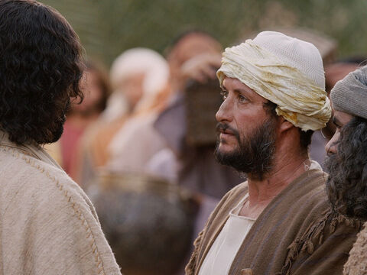
A Priority Commitment
Mark 10:20-27
20 And he answered and said unto him, Master, all these have I observed from my youth.

Slide 37
“Christ was drawn to this young man. He knew him to be sincere in his assertion, “All these things have I kept from my youth.” The Redeemer longed to create in him that discernment which would enable him to see the necessity of heart devotion and Christian goodness.”
The Desire of Ages p. 519

Slide 38
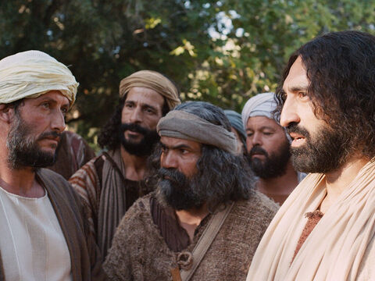
A Priority Commitment
Mark 10:21-27
21 Then Jesus beholding him loved him, and said unto him, One thing thou lackest: go thy way, sell whatsoever thou hast, and give to the poor, and thou shalt have treasure in heaven: and come, take up the cross, and follow me.

Slide 39
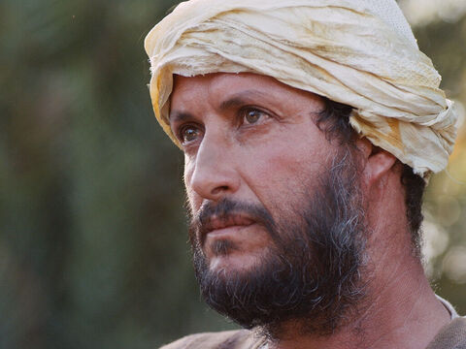
A Priority Commitment
Mark 10:22-27
22 And he was sad at that saying, and went away grieved: for he had great possessions.

Slide 40
A Priority Commitment
Mark 10:22-27
23 And Jesus looked round about, and saith unto his disciples, How hardly shall they that have riches enter into the kingdom of God!

Slide 41
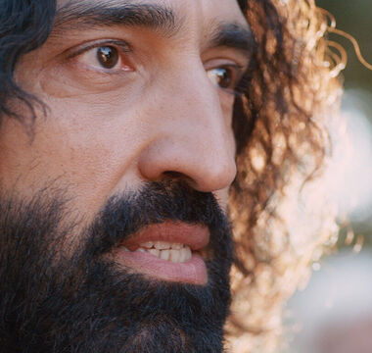
A Priority Commitment
Mark 10:24-27
24 And the disciples were astonished at his words. But Jesus answereth again, and saith unto them, Children, how hard is it for them that trust in riches to enter into the kingdom of God!

Slide 42
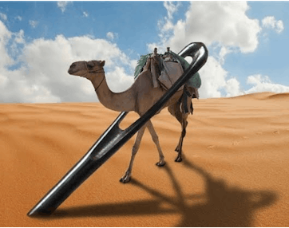
A Priority Commitment
Mark 10:25-27
25 It is easier for a camel to go through the eye of a needle, than for a rich man to enter into the kingdom of God.

Slide 43
The Eye of the Needle
“
The "Eye of the Needle" was indeed a narrow gateway into Jerusalem. Since camels were heavily loaded with goods and riders, they would need to be un-loaded in order to pass through. Therefore, the analogy is that a rich man would have to similarly unload his material possessions in order to enter heaven.
”

Slide 44
The Eye of the Needle
“
The "Eye of the Needle" was indeed a narrow gateway into Jerusalem. Since camels were heavily loaded with goods and riders, they would need to be un-loaded in order to pass through. Therefore, the analogy is that a rich man would have to similarly unload his material possessions in order to enter heaven.
”

Slide 45
SDABC on Matthew 19:24
“
The explanation that the “eye of a needle” refers to a smaller gate cut in the panel of a large city gate, through which men might pass when the large gate was closed to major traffic, originated in the centuries after Christ’s day.
”

Slide 46
SDABC on Matthew 19:24
“
There is, therefore, no valid basis for such an explanation, plausible though it may appear. Jesus is dealing with impossibilities (as He mentions in Mark 10:27), and there is no point in contriving an explanation by which to render possible what Jesus specifically points out as impossible.
”

Slide 47
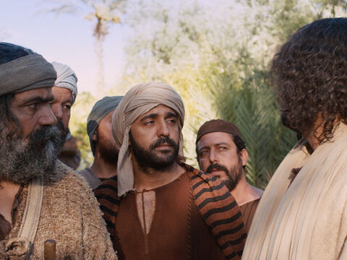
A Priority Commitment
Mark 10:26-27
26 And they were astonished out of measure, saying among themselves, Who then can be saved?

Slide 48

“If prestige, influence, and wealth are not evidences of divine favor, the disciples reasoned, those who lack these have even less chance.”
SDABC on Matthew 19:25

Slide 49
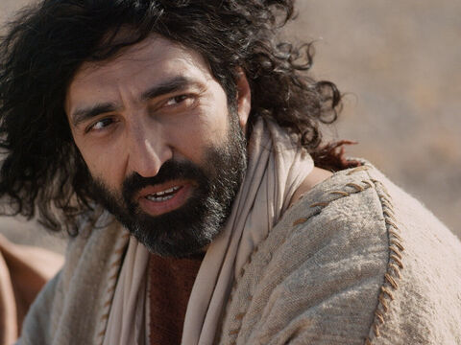
A Priority Commitment
Mark 10:27
27 And Jesus looking upon them saith, With men it is impossible, but not with God: for with God all things are possible.

Slide 50
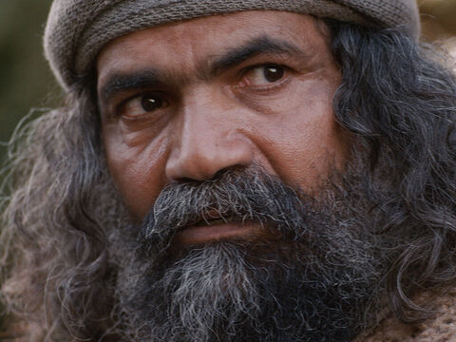
Faithful Commitment: Mark 10:28-31
28 Then Peter began to say unto him, Lo, we have left all, and have followed thee.
Peter’s thoughts were on the rewards of discipleship. Self denial practiced with one eye diverted in the direction of the expected reward will never merit the “well done” that Heaven waits to bestow for faithful service.

Slide 51
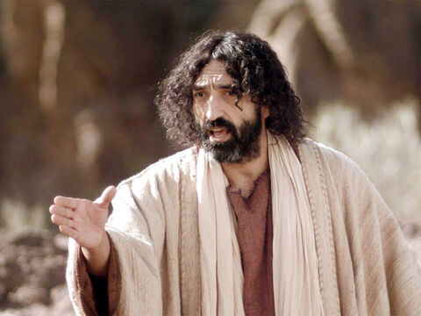
Faithful Commitment: Mark 10:29-31
29 And Jesus answered and said, Verily I say unto you,
There is no man that hath left house, or brethren, or sisters, or father, or mother, or wife, or children, or lands, for my sake, and the gospel's,

Slide 52
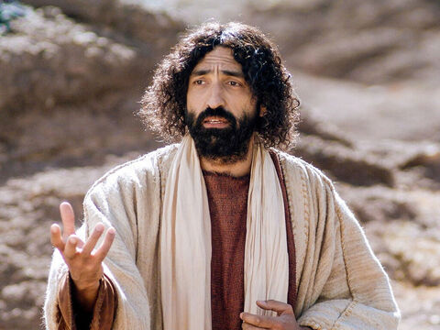
Faithful Commitment: Mark 10:30-31
30 But he shall receive an hundredfold now in this time, houses, and
brethren, and sisters, and mothers, and children, and lands, with persecutions; and in the world to come eternal life.

Slide 53
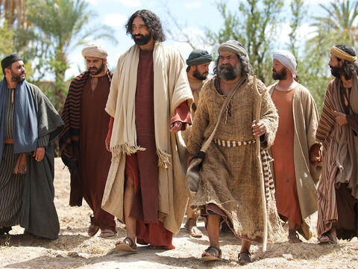
Faithful Commitment: Mark 10:31
31 But many that are first shall be last; and the last first.
Earthly success and popularity are based on altogether different standards from those by which God estimates a man’s worth.

Slide 54
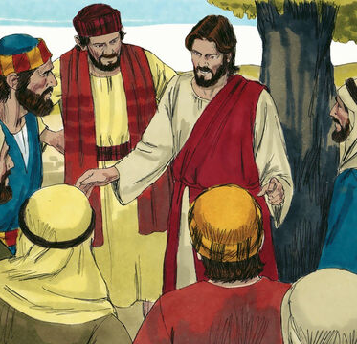
Self and Service
Mark 10:32-45
32 And they were in the way going up to Jerusalem; and Jesus went before them: and they were amazed; and as they followed, they were afraid. And he took again the twelve, and began to tell them what things should happen unto him,

Slide 55
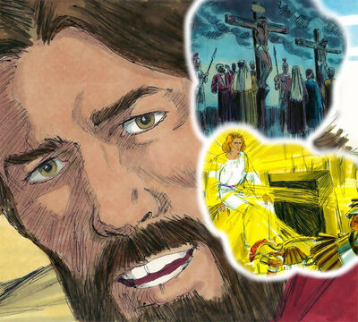
Self and Service
Mark 10:33-45
33 Saying, Behold, we go up to Jerusalem; and the Son of man shall be delivered unto the chief priests, and unto the scribes; and they shall condemn him to death, and shall deliver him to the Gentiles:

Slide 56
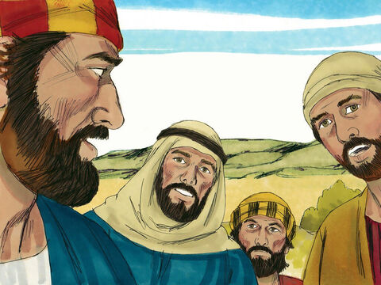
Self and Service
Mark 10:34-45
34 And they shall mock him, and shall scourge him, and shall spit upon him, and shall kill him: and the third day he shall rise again.

Slide 57
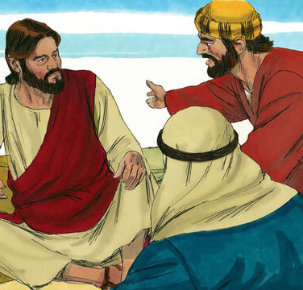
Self and Service
Mark 10:35-45
35 And James and John, the sons of Zebedee, come unto him, saying, Master, we would that thou shouldest do for us whatsoever we shall desire.
36 And he said unto them, What would ye that I should do for you?

Slide 58
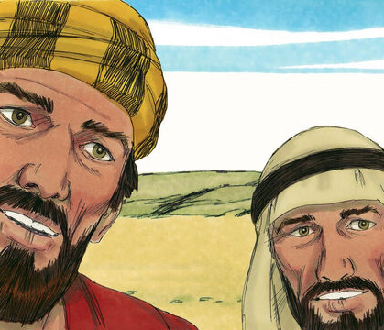
Self and Service
Mark 10:37-45
37 They said unto him, Grant unto us that we may sit, one on thy right hand, and the other on thy left hand, in thy glory.
38 But Jesus said unto them, Ye know not what ye ask: can ye drink of the cup that I drink of? and be baptized with the baptism that I am baptized with?

Slide 59
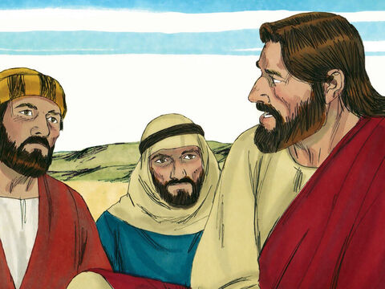
Self and Service
Mark 10:39-45
39 And they said unto him, We can. And Jesus said unto them, Ye shall indeed drink of the cup that I drink of; and with the baptism that I am baptized withal shall ye be baptized:

Slide 60
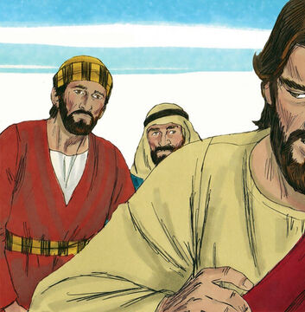
Self and Service
Mark 10:40-45
40 But to sit on my right hand and on my left hand is not mine to give; but it shall be given to them for whom it is prepared.

Slide 61
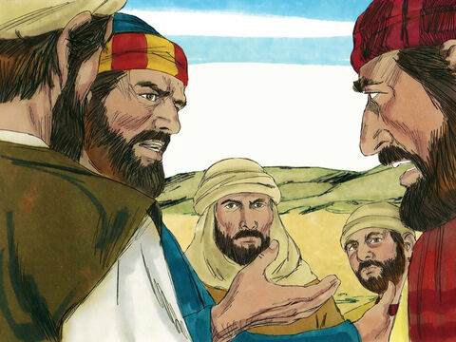
Self and Service
Mark 10:41-45
41 And when the ten heard it, they began to be much displeased with James and John.

Slide 62
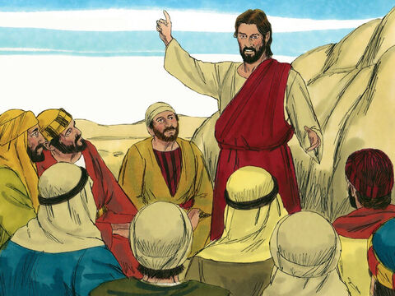
Self and Service
Mark 10:42-45
42 But Jesus called them to him, and saith unto them, Ye know that they which are accounted to rule over the Gentiles exercise lordship over them; and their great ones exercise authority upon them.

Slide 63
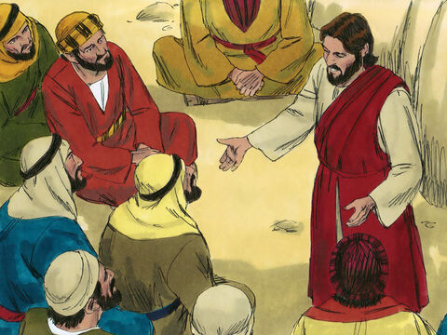
Self and Service
Mark 10:43-45
43 But so shall it not be among you: but whosoever will be great among you, shall be your minister:
44 And whosoever of you will be the chiefest, shall be servant of all.

Slide 64
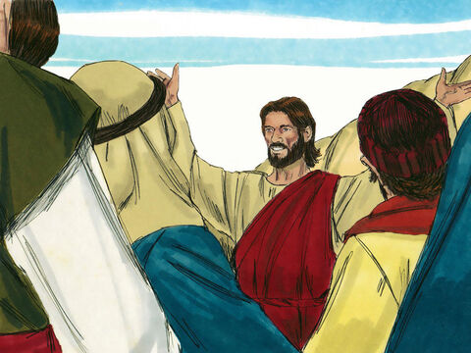
Self and Service
Mark 10:45
45 For even the Son of man came not to be ministered unto, but to minister, and to give his life a ransom for many.

Slide 65
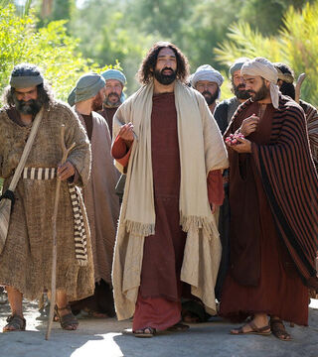
A Committed Example
Mark 10:46-52
46 And they came to Jericho: and as he went out of Jericho with his disciples and a great number of people, blind Bartimaeus, the son of Timaeus, sat by the highway side begging.

Slide 66
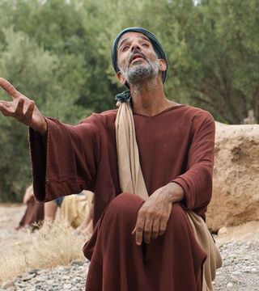
A Committed Example
Mark 10:47-52
47 And when he heard that it was Jesus of Nazareth, he began to cry out, and say, Jesus, thou son of David, have mercy on me.

Slide 67
A Committed Example
Mark 10:47-52
47 And when he heard that it was Jesus of Nazareth, he began to cry out, and say, Jesus, thou son of David, have mercy on me.

Slide 68
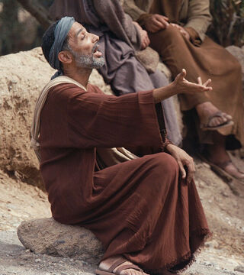
A Committed Example
Mark 10:48-52
48 And many charged him that he should hold his peace: but he cried the more a great deal, Thou son of David, have mercy on me.

Slide 69
Son of David
“
The use of the strictly Messianic title “Son of David” implies some degree of recognition of Jesus as the Promised One.
”

Slide 70
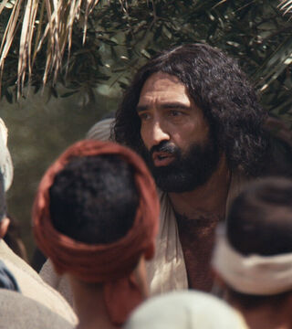
A Committed Example
Mark 10:49-52
49 And Jesus stood still, and commanded him to be called. And they call the blind man, saying unto him, Be of good comfort, rise; he calleth thee.

Slide 71
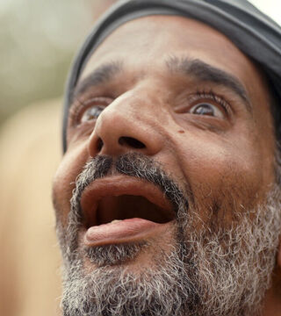
A Committed Example
Mark 10:50-52
50 And he, casting away his garment, rose, and came to Jesus.

Slide 72
The Outer Garment
“
The “mantle,” or outer garment, was commonly used as a covering at night. The poor would sometimes have little or nothing besides the “mantle” to offer as security for a loan. The law of Moses, however, prohibited a creditor from retaining this garment overnight as a pledge (Ex. 22:26, 27). It was essentially cloak, tent, and sleeping bag for the very poor. To cast away his only security signifies a true commitment to faith.
”

Slide 73
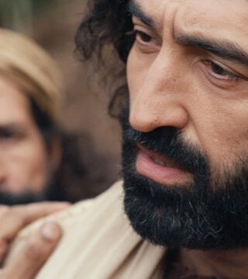
A Committed Example
Mark 10:51-52
51 And Jesus answered and said unto him, What wilt thou that I should do unto thee? The blind man said unto him, Lord, that I might receive my sight.

Slide 74
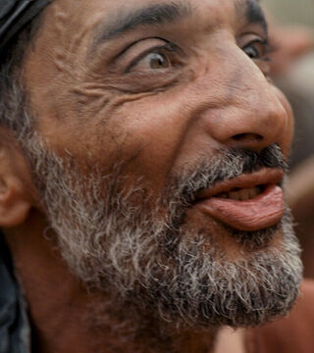
A Committed Example
Mark 10:52
52 And Jesus said unto him, Go thy way; thy faith hath made thee whole. And immediately he received his sight, and followed Jesus in the way.

Slide 75
Thank you!
Happy Sabbath!!

